Slide 1

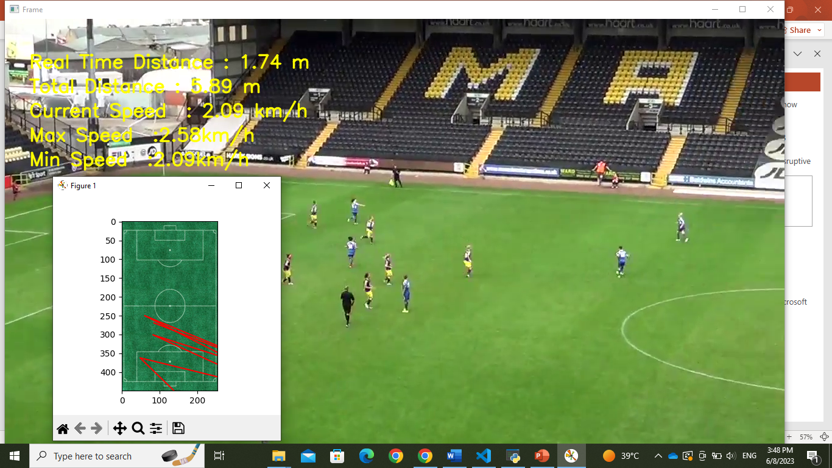
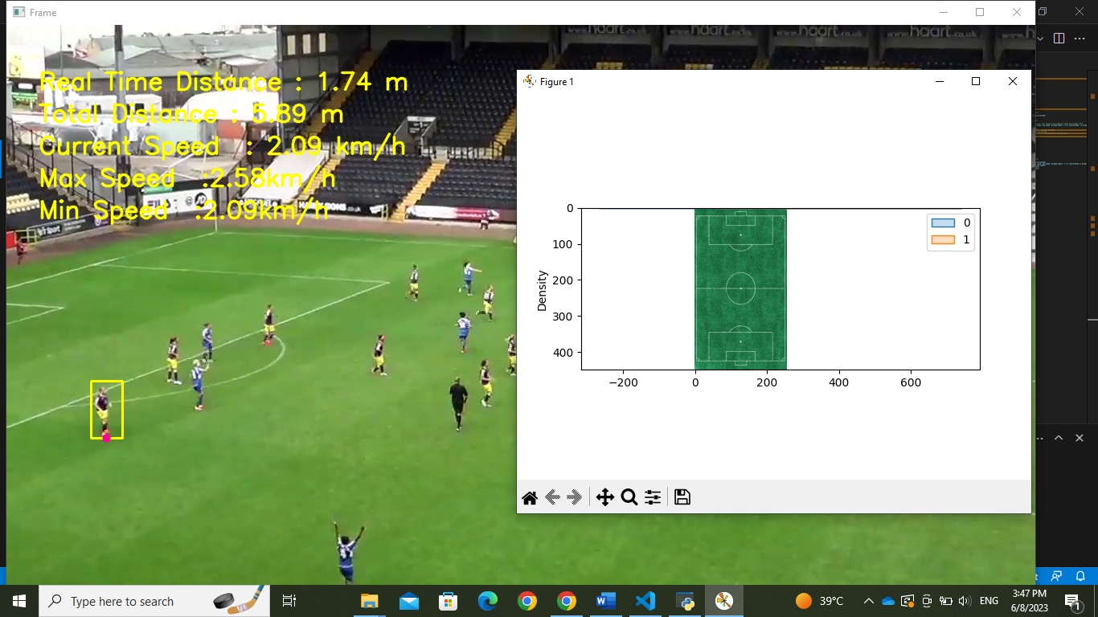
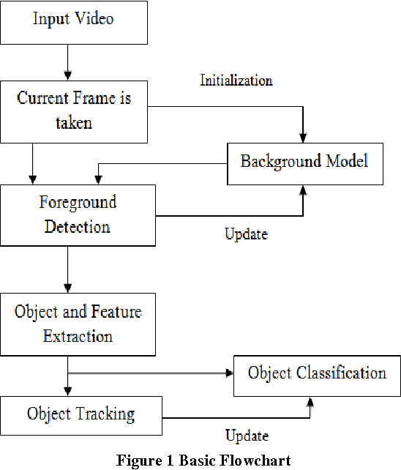
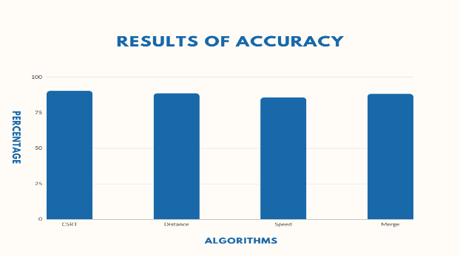
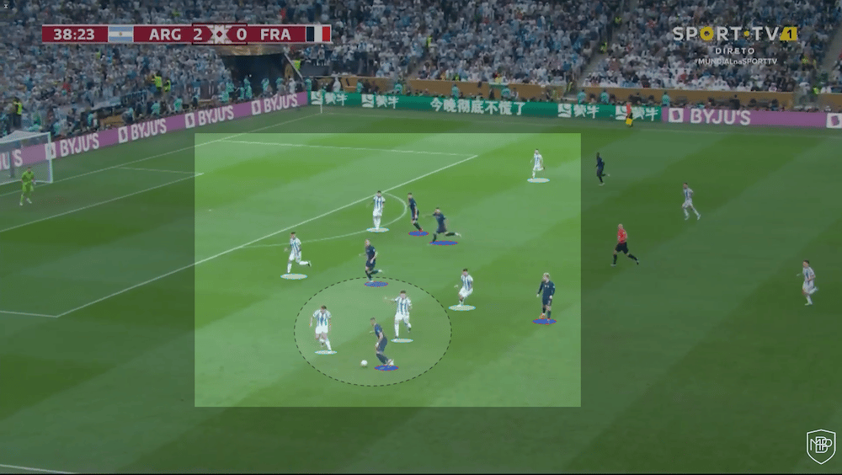
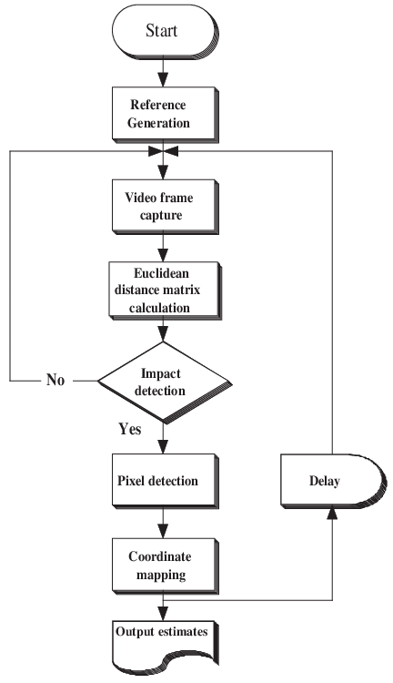
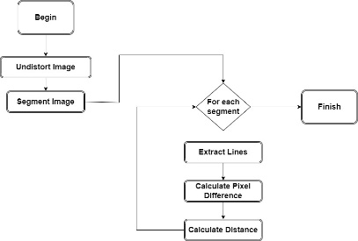
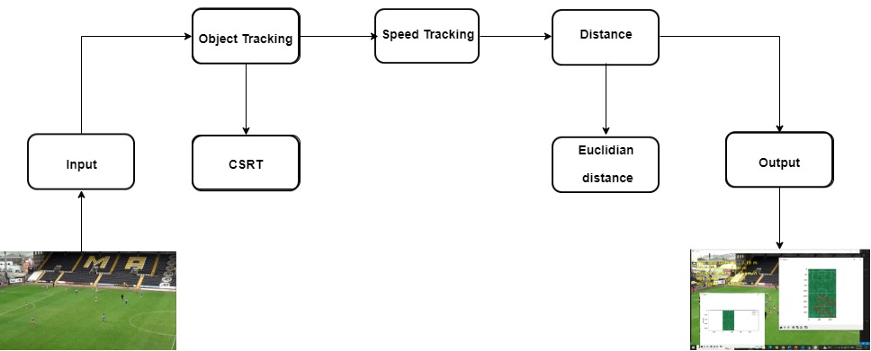

Title : Analyzing Football Players Performance by: Malek Tarek Ahmed supervisor Dr.Ann Nossier
Abstract
System Design/ Interface
CSRT tracking algorithm
Results
This project uses computer vision to detect and track players in a video. The project outputs the speed, max speed, min speed, and a gif for players movement to detect how much distance the player has covered. The goal of this project is to help players perform better technically and physically by providing them with feedback on their performance The project can be used by coaches and players to analyze player performance. Coaches can use the project to identify areas where players need to improve, also players.
is a robust and accurate algorithm that can track objects in videos even under challenging conditions, such as occlusion and illumination changes.
Distance Algorithm
works by first calculating the squared distances between the x-coordinates and the y-coordinates of the two points. It then takes the square root of the sum of these squared distances. This gives us the distance between the two points.
x_k = A * x_{k-1} + B * u_k + w_k
The accuracy of the CSRT was 90.32 % and the Distance: 88.6% and the Speed: 85.7% and after merging them they got 88.2% accuracy.
Proposed System
Speed calculation Algorithm
Conclusions
The tool demonstrates high efficiency by accurately tracking the player's movement, gathering detailed statistics, and creating a visually appealing heat map and GIF that vividly illustrate the player's on-field trajectory. It offers comprehensive analysis and visualization, enabling a thorough evaluation of the player's performance and tactics.
Euclidean filter d = sqrt((x2 - x1)**2 + (y2 - y1)**2)
Once the objects have been tracked, their speed can be calculated by measuring the distance they travel between frames. This is done using the distance() function in the cv2 library.
Speed= distance/time

